Slide 1

Risk Game Build 3
TEAM 8

Slide 2
Contents
Goal
Architectural Diagram
Junit
JavaDoc
Coding Conventions

Slide 3
Goal
To successfully build the Risk Game according to the given build requirements.
Map Editor
Game Play
Programming Process

Slide 4
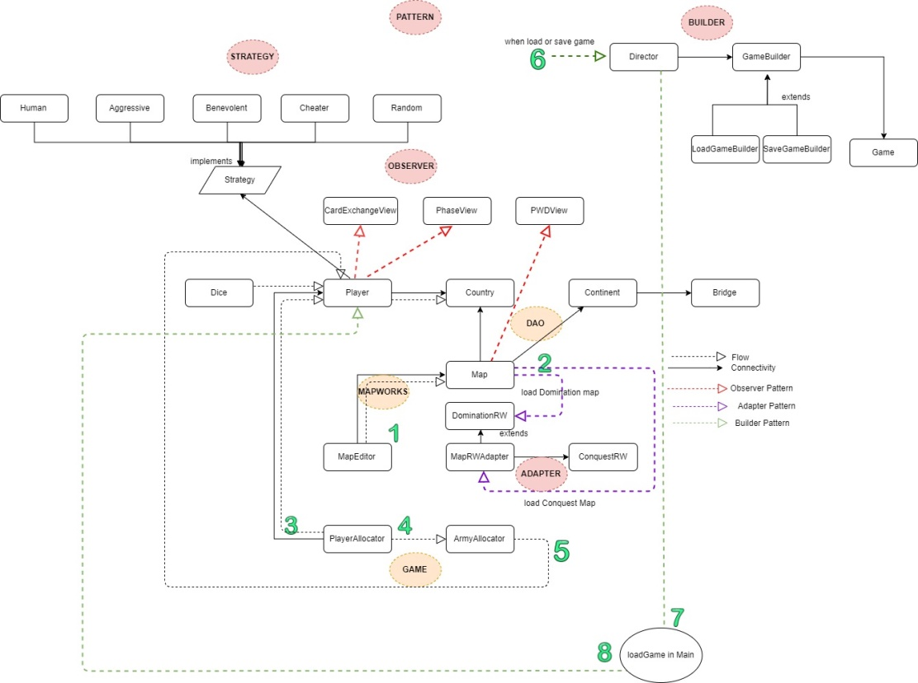
Architectural Diagram

